Slide 1

SHIVNAGAR VIDYA PRASARAK MANDAL'S
COLLEGE OF ENGINEERING, MALEGAON (BK)-BARAMATI.
BE Engineering
in
Electronics and Telecommunication Department

Slide 2

In Vehicle Network Safety Established over CAN Communication protocol
OCTOBER 2024
PRESENTED BY: GADEKAR POURNIMA
SHAIKH ARBAJ
JAGTAP TUSHAR
HAJARE KIRAN
Guided By : Dr. N. A. Doshi

Slide 3
Outline of Talk
Role Of Microcontrollers in Automotive Industry
ECU1 to ECU2: Use-case Diagram
System Block Diagram
Hardware Block Diagram
System Interface Diagram
Software Architecture Diagram
Sequence Diagram
CAN frame Types
Error Types
Implement & integrate CAN-stack on two different micro-controller
Define two CAN frames with E2E profile
E2E Protocols
References
Q&A Session

Slide 4
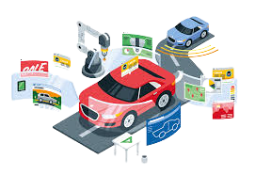
Role Of Microcontrollers in the Automotive Industry
Microcontrollers are used in a wide variety of automotive applications, including:
Engine control
Braking systems
Airbag systems
Transmission control
Advanced driver assistance systems (ADAS)
Infotainment systems

Slide 5
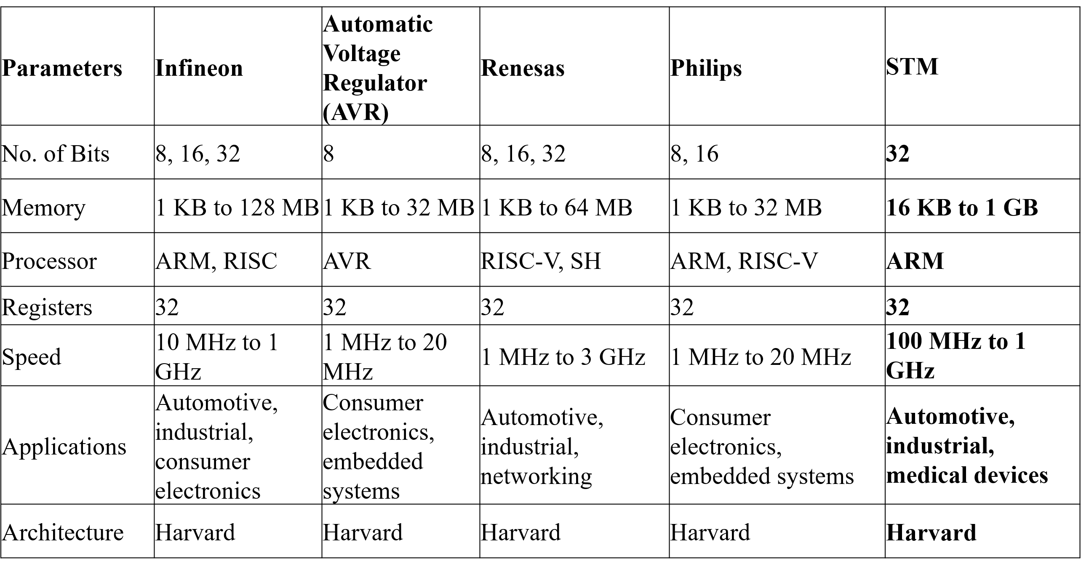
Micro Controllers Used in Automotive Industry

Slide 6
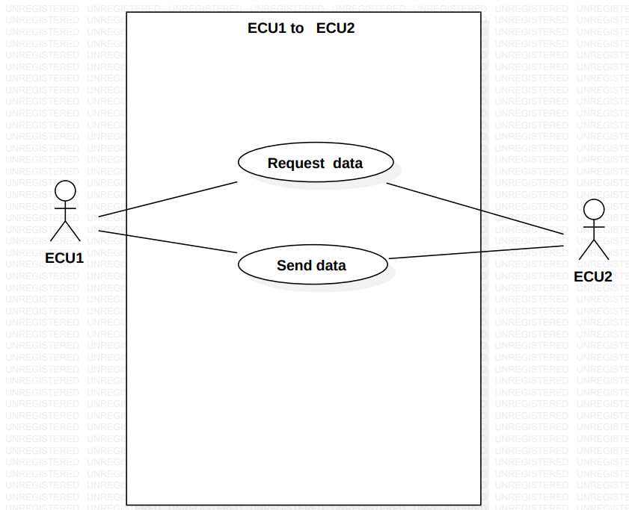
ECU1 to ECU2: Use-case Diagram

Slide 7
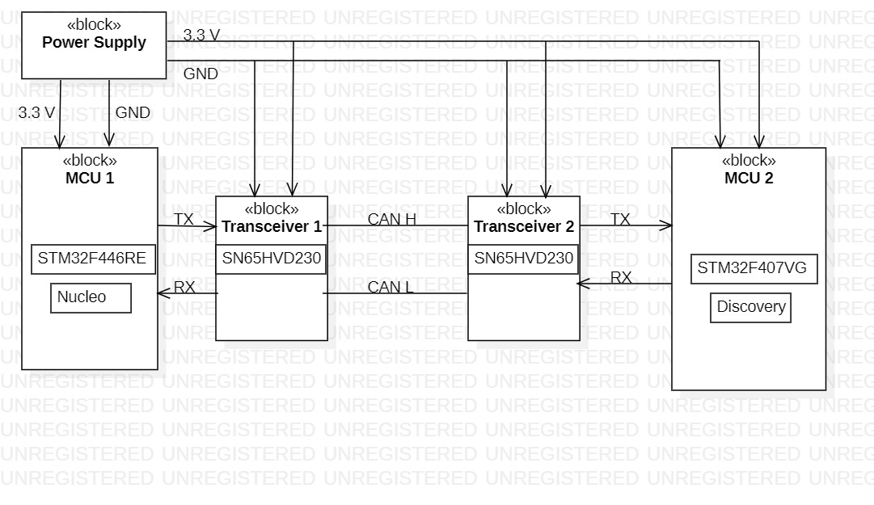
System Block Diagram

Slide 8
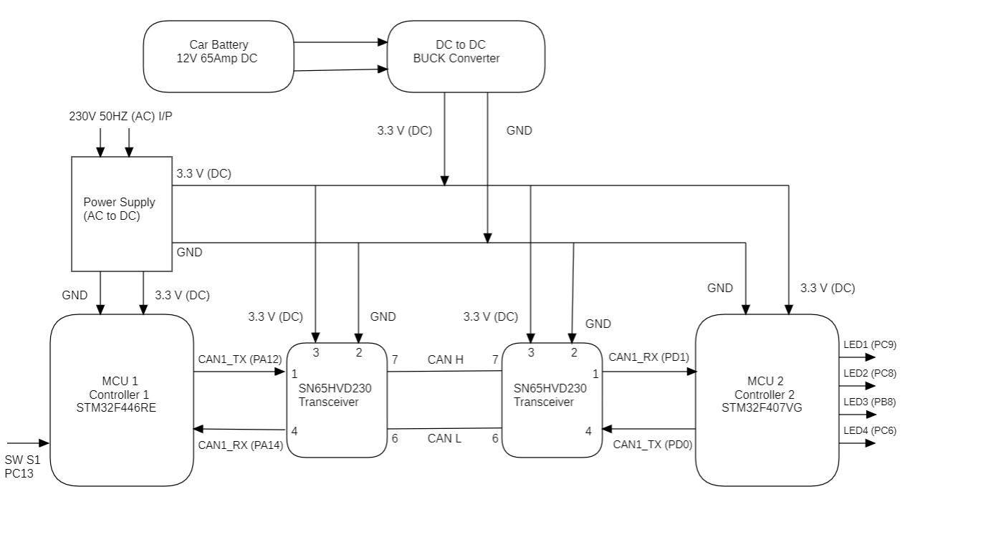
Hardware Block Diagram

Slide 9
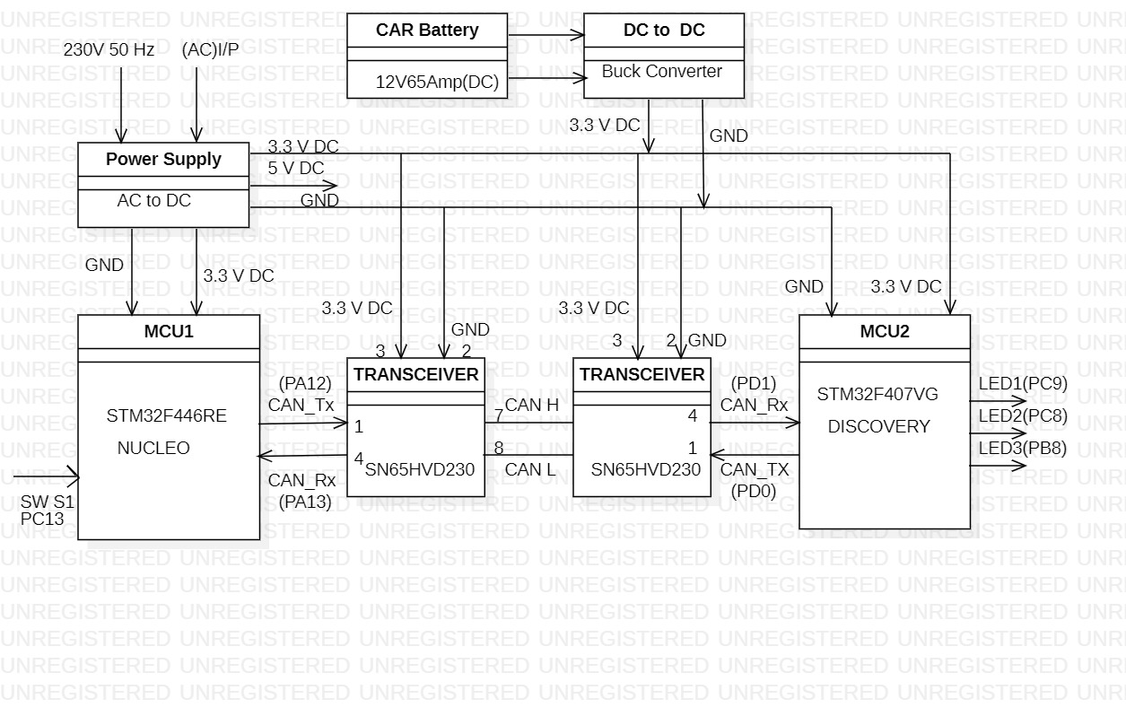
System Interface Diagram:

Slide 10
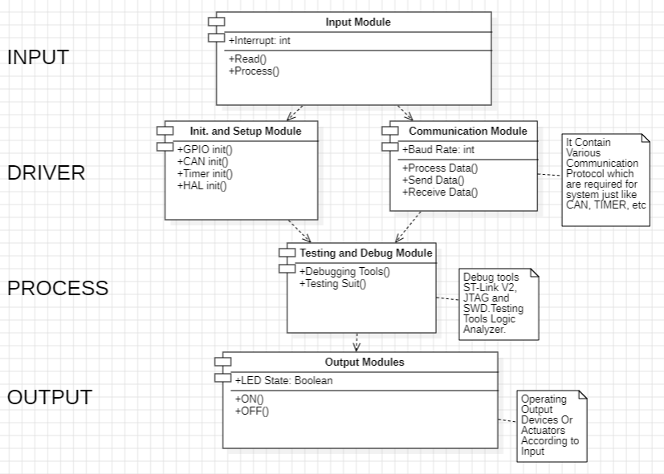
Software Architecture Diagram

Slide 11
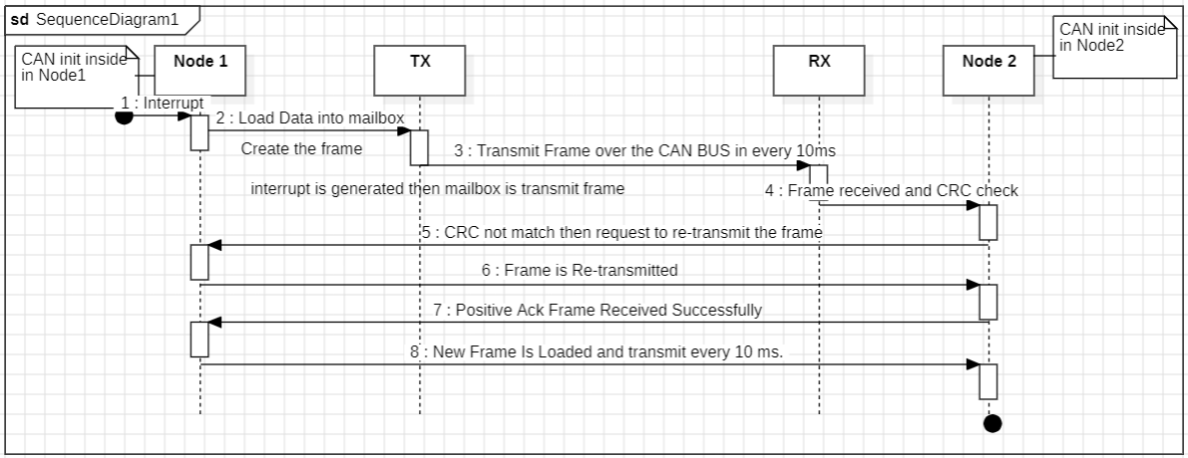
Sequence Diagram

Slide 12
Frame Types and Roles of Each Frame
Sr.no | Frame | Roles of frame
1 | Data frame | This frame is used by the transmit unit to send a message to the receive unit.
2 | Remote frame | This frame is used by the receive unit to request transmission of a message that has the same ID from the transmit unit.
3 | Error frame | When an error is detected, this frame is used to notify other units of the detected error
4 | Overload frame | This frame is used by the receive unit to notify that it has not been prepared to receive frames yet

Slide 13
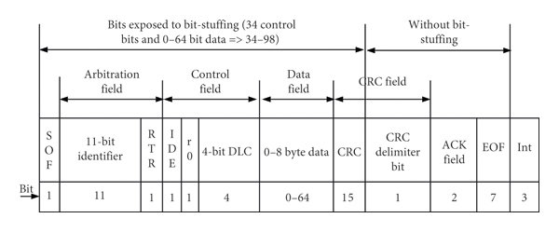
Data Frame Format
SOF – Start of Frame, Identifier – Tells the content of message and priority
RTR – Remote Transmission Request, IDE – Identifier extension
DLC – Data Length Code Data – holds up to 8 bytes of data
CRC – “Cyclic Redundant Check” sum ACK – Acknowledge
EOF – End of Frame IFS – Intermission Frame Space.

Slide 14
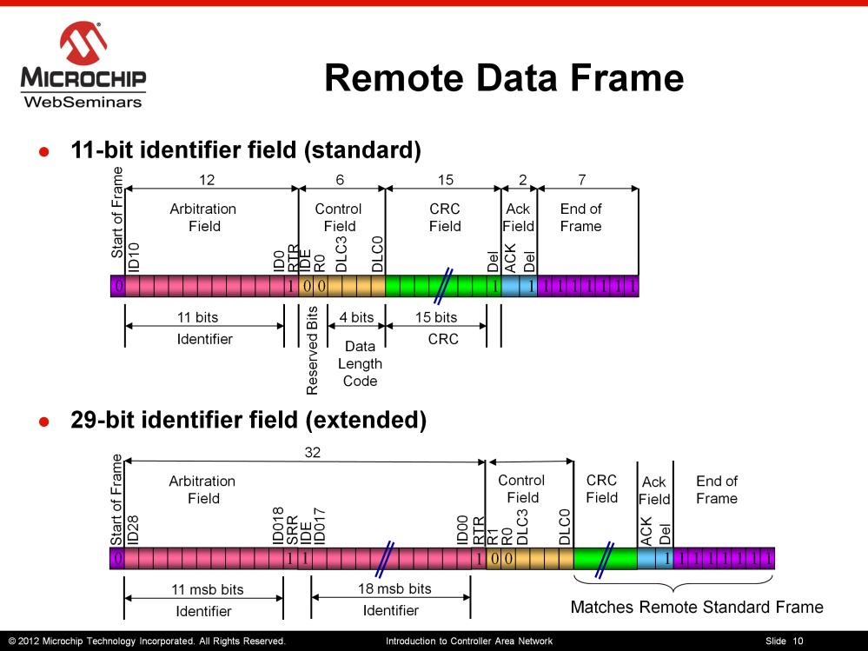
Remote Frame
RTR bit is Recessive and there is no Data

Slide 15
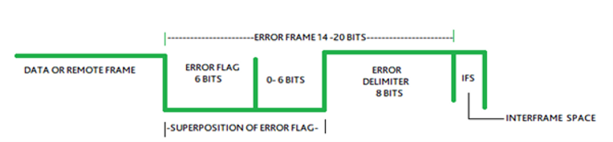
Error Frame

Slide 16
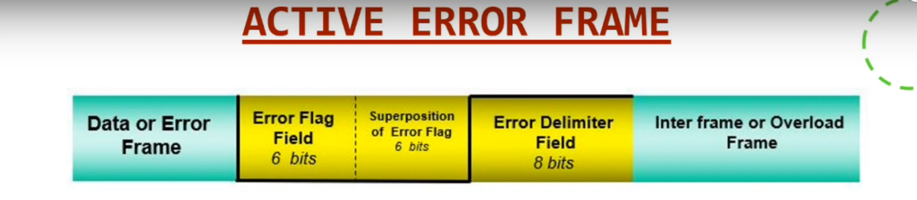
Error States of CAN Bus
Error Active
When the limit is below TEC (Transmit Error Counter) <127 and REC (Receive Error Counter) <127, an Error Active node will transmit Active Error Flags when it detects errors.

Slide 17
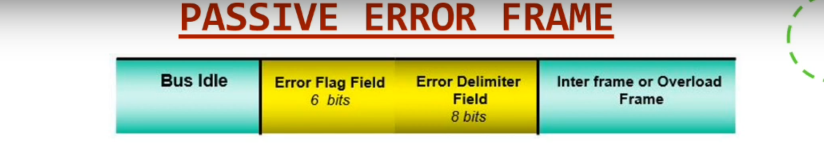
Error States of CAN Bus
Error Passive
When any one of the two Error Counters raises above 127(TEC>127 and REC>127), the node will enter a state known as Error Passive.

Slide 18
Bus Off
When the Transmit Error Counter raises above 255(TEC>255 and REC>255), the node will enter the Bus Off state. It happens when the CAN controller fails or at times of extreme accumulations of errors. In this case, the CAN controller disconnects itself from the CAN bus. As a result, that particular CAN node will get switched off from the CAN network; Resulting in no communication at all.

Slide 19
Bit arbitration
Bit arbitration is a crucial process in the Controller Area Network (CAN) protocol. It refers to how nodes on a CAN bus determine which message will be transmitted when multiple nodes attempt to send data simultaneously.
The Arbitration Field, which determines the priority of the message when two or more nodes are contending for the bus.
Lower ID numbers indicate higher priority.

Slide 20
Bit arbitration
Suppose you have two CAN nodes, Node A and Node B, both wanting to transmit a message on the CAN bus.
1. Start of Frame (SOF): The bus is initially in an idle state with all nodes in recessive mode (high-level, logic 1). When a node decides to transmit, it sends a dominant (low-level, logic 0) bit to signal the start of its message. This is called the Start of Frame (SOF) bit.
- Node A wants to transmit a message with an ID of 0x123.
- Node B wants to transmit a message with an ID of 0x456.

Slide 21
Bit arbitration
Arbitration Field:
- Node A transmits its ID 0x123 (binary: 0001 0010 0011) bit by bit.
- Node B simultaneously transmits its ID 0x456 (binary: 0100 0101 0110) bit by bit.
During arbitration, the nodes compare the bits they are transmitting to the bits they observe on the bus. If at any point, a node sees a dominant bit when it intends to send a recessive bit, it backs off immediately. In this example, Node A transmits a dominant bit for the first arbitration bit (0) and Node B transmits a recessive bit. Node A wins arbitration for the first bit

Slide 22
Implement & integrate CAN-stack on two different micro-controller
CAN stack means that these layers are designed as separate, interchangeable modules, each responsible for a specific set of functionalities.
This modular design allows for easier development, testing, and maintenance of the CAN stack, as each module can be developed and tested independently.
It also allows for flexibility in choosing different implementations for each layer, depending on the application’s requirements.

Slide 23
Frame 1 for Data Transmission
Complete CAN Frame
Arbitration Field
Control
Data
CRC Field
End of Frame
11
4
8
15
7
Start of frame
IDE Bit
Ack. Delimiter
Requ. Remote
Reserved
Ack. Slot Bit
CRC Delimiter
CRC13
CRC8
CRC12
CRC10
CRC14
CRC11
CRC9
CRC7
ID10
DB0
CRC5
CRC3
CRC1
CRC6
CRC2
EOF5
IFS1
CRC0
EOF6
EOF3
IFS2
IFS0
CRC4
EOF4
EOF2
EOF1
ID9
ID8
ID4
ID3
ID2
ID1
DB7
DB4
EOF0
DL0
DB5
ID7
ID5
ID0
DL3
DL1
DB6
DB2
DB1
ID6
DL2
DB3
Data Content
0 | 0 | 0 | 0 | 0 | 1 | 1 | 0 | 0 | 1 | 0 | 1 | 0 | 0 | 0 | 0 | 0 | 0 | 1 | 0 | 1 | 1 | 0 | 0 | 1 | 0 | 1 |  |  |  |  |  |  |  |  |  |  |  |  |  |  |  | 1 | 0 | 1 | 1 | 1 | 1 | 1 | 1
1
1
1
1
1
Data Content
0 | 1 | 1 | 0 | 0 | 1 | 0 | 1

Slide 24
Frame 2 for Data Reception
Complete CAN Frame
Arbitration Field
Control
Data
CRC Field
End of Frame
11
4
8
15
7
Start of frame
IDE Bit
Requ. Remote
Ack. Delimiter
Reserved
Ack. Slot Bit
CRC Delimiter
CRC13
CRC8
CRC12
CRC10
CRC14
CRC11
CRC9
CRC7
ID10
DB0
CRC5
CRC3
CRC1
CRC6
CRC2
EOF5
IFS1
CRC0
EOF6
EOF3
IFS2
IFS0
CRC4
EOF4
EOF2
EOF1
ID9
ID8
ID4
ID3
ID2
ID1
DB7
DB4
EOF0
DL0
DB5
ID7
ID5
ID0
DL3
DL1
DB6
DB2
DB1
ID6
DL2
DB3
Data Content
0 | 0 | 0 | 0 | 0 | 1 | 0 | 1 | 0 | 0 | 0 | 1 | 0 | 0 | 0 | 0 | 0 | 0 | 1 | 0 | 0 | 0 | 0 | 0 | 0 | 0 | 1 |  |  |  |  |  |  |  |  |  |  |  |  |  |  |  | 1 | 0 | 1 | 1 | 1 | 1 | 1 | 1
1
1
1
1
1
Data Content
0 | 1 | 0 | 1 | 0 | 0 | 0 | 1

Slide 25
Define two CAN frames with E2E profile resp
E2E profile in CAN frames is to enhance the reliability of data transmission by adding checksum and sequence number checks.
This helps detect and mitigate errors that may occur during data transmission over the CAN bus, improving the overall robustness of the communication system.
E2E Data Frame:
Frame Type: Data frame.
Purpose: To transmit application data with added end-to-end checks for integrity and consistency.
Structure: Contains the application data along with additional E2E checksum and sequence number fields.
E2E Checksum: A checksum calculated over the entire data field to detect errors in the data.
Sequence Number: A field that increments with each transmitted frame, allowing the receiver to detect missing or out-of-order frames.
E2E Error Frame:
Frame Type: Error frame.
Purpose: To notify the sender and other nodes of an error detected by the E2E checks in a received data frame.
Structure: Contains the sequence number of the erroneous frame along with an error status code.
Error Status Code: Indicates the type of error detected, such as checksum error or sequence number mismatch.

Slide 26
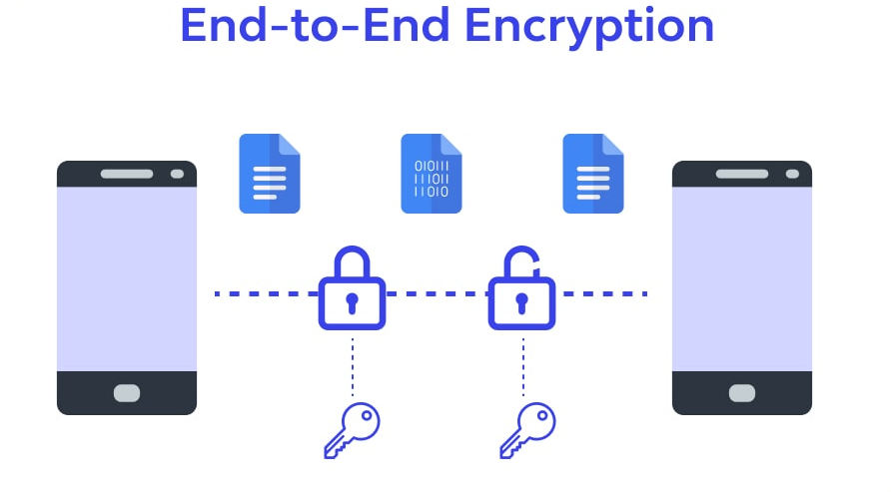
E2E Protocols: Freshness & Checksum
Freshness:
Freshness in E2E safety refers to ensuring that messages are current and not replayed from a previous communication session. It involves adding a time-based or sequence-based value to messages to prevent replay attacks.
Checksum:
A checksum is a value calculated from the data in a message that is used to detect errors or tampering during transmission. It helps ensure data integrity by verifying that the received message matches the transmitted one.
Image Source: https://www.wallarm.com/what/what-is-end-to-end-encryption

Slide 27
References
Brayanov, N., and Stoynova, A. (2018). Multi-Microcontroller Emulation of Sensors, Actuators and Systems for Flexible Integration of Complex Devices. In 2018 41st International Spring Seminar on Electronics Technology (ISSE), pages 1-5.
Lin, Y., Conners, J., & Livengood, S. (2017, October). Assessing the use of open source microcontroller board for teaching engine sensing and communication in automotive laboratory. In 2017 IEEE Frontiers in Education Conference (FIE), pages 1-8.
H. Kopka and P. W. Daly, A study on the design and manufacture of HVAC Double Cylinder Motor for a car blower ,International Conference on Electrical Machines and Systems Nov 2009.
Z. M. Durovic and B. D. Kovacevic Control of heating, ventilation and air conditioning system based on neural network , 3rd ed. 7th Seminar on Neural Network Applications in Electrical Engineering, Sept 2004.

Slide 28
THANKS

Slide 29
Questions Please ?

